Slide 1


University Of Limerick
HUMAN-IN-THE-LOOP MACHINE LEARNING FOR REAL TIME FEEDBACK SYSTEMS
Anish Kamble
Supervisor: Dr Eberhard Mayerhofer
MSc in Data Science and Statistical Learning

Slide 2
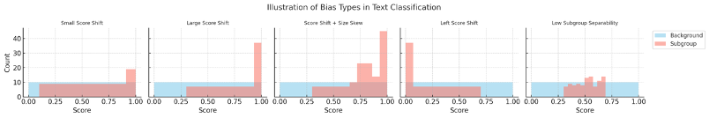
WHY TOXICITY DETECTION MATTERS?
Toxic content harms users and online communities.
Automated models fail with contextual nuances (sarcasm, slang, reclaimed slurs).
Models also show bias: unfair misclassification of minority groups.

Slide 3
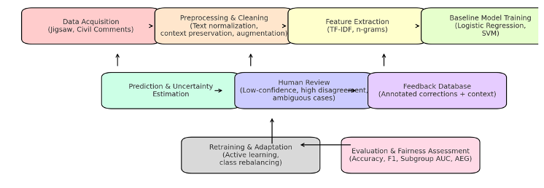
RESEARCH OBJECTIVE
Develop a baseline toxicity detection model using TF–IDF + Logistic Regression.
Incorporate Human-in-the-Loop (HIL) for ambiguous or low-confidence cases.
Evaluate performance improvements after feedback (precision, recall, F1, AUC).

Slide 4
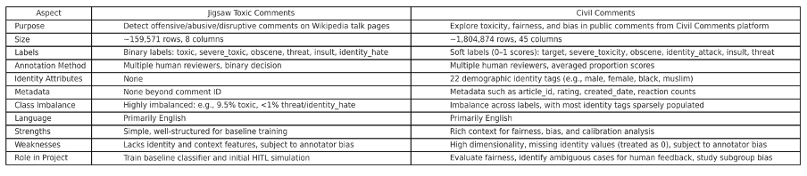
DATASETS
Jigsaw Toxic Comments
~150,000 Wikipedia talk page comments.
6 labels: toxic, severe toxic, obscene, threat, insult, identity hate.
Known issues: imbalance, annotator bias.
Civil Comments
~2 million comments (2015–2017).
Same labels + metadata (e.g., source, anonymity).
Multiple annotators → inter-rater agreement possible.

Slide 5
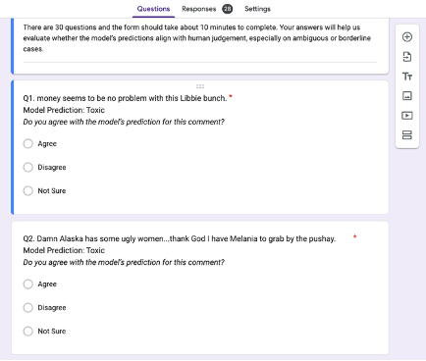
FEEDBACK FORM:

Slide 6

DATA PREPARATION
Tokenization & lowercasing.
Lemmatization/stemming for linguistic normalization.
Removed irrelevant whitespace/punctuation.
Train–validation–test split: 80:10:10 with stratification.

Slide 7
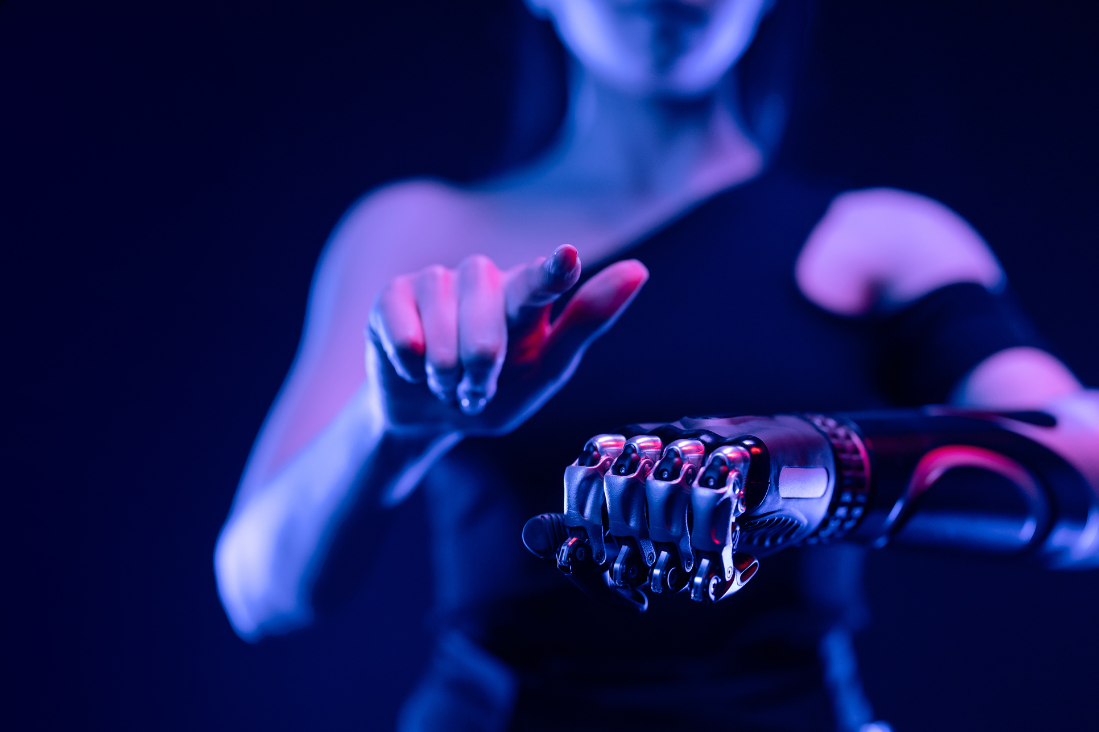
FEATURE EXTRACTION
Convert cleaned text into numerical vectors.
Word n-grams (unigrams + bigrams) → short context.
TF–IDF weighting balances word frequency vs. informativeness.
Chosen over embeddings for interpretability, efficiency, and HIL-friendliness.

Slide 8
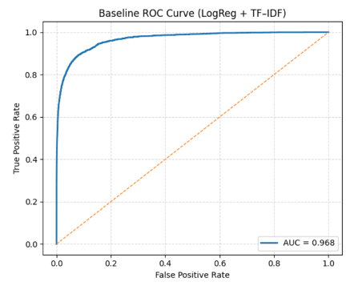
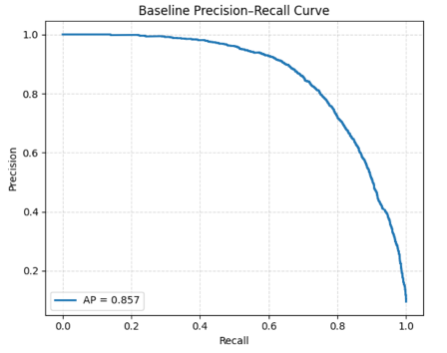
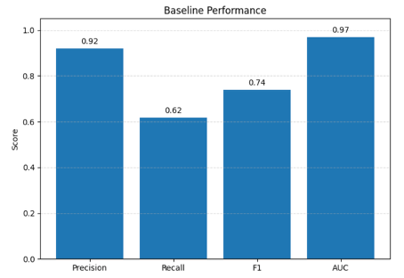
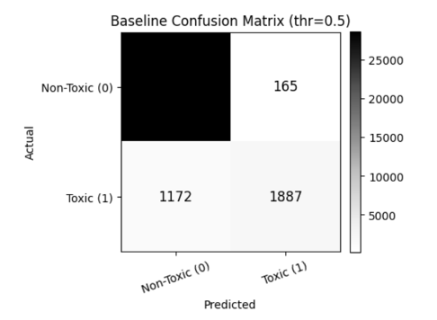
BASELINE MODEL

Slide 9
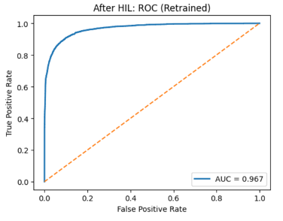
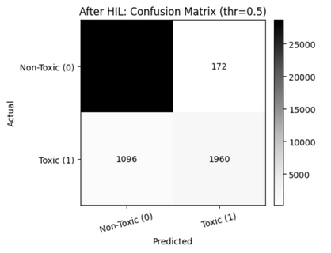
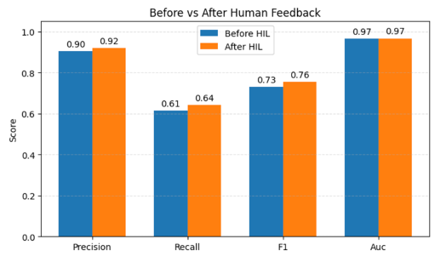
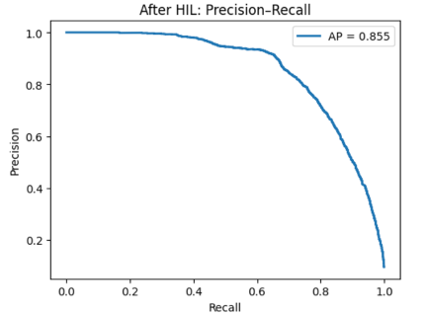
AFTER MODEL INTERGRATION

Slide 10
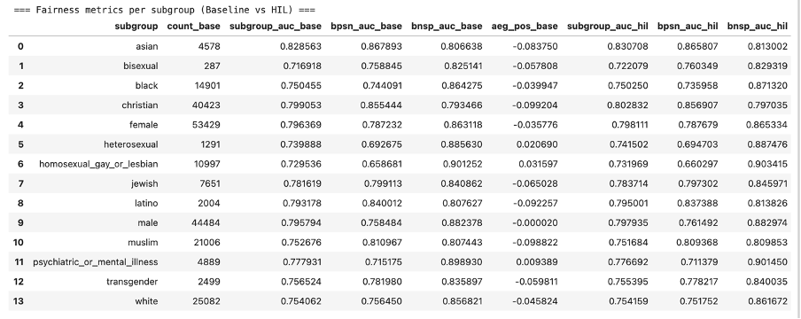
FAIRNESS AND BIAS ANALYSIS
Subgroup performance comparison: Baseline vs. HIL
Metrics: Subgroup AUC, BPSN AUC, BNSP AUC
Human feedback reduced bias across sensitive subgroups

Slide 11
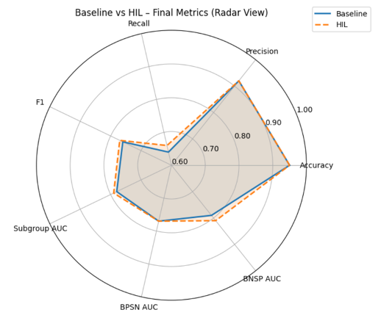
DISCUSSION
HIL improved recall, fairness, and F1
Minimal trade-offs in precision and AUC
Stronger handling of edge cases
Moves closer to real-world deployment

Slide 12
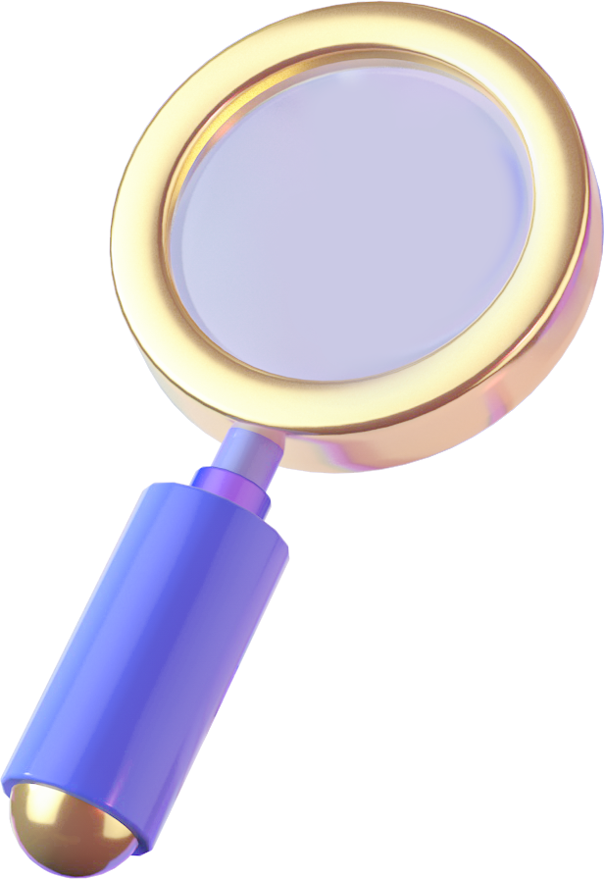
CONCLUSION
Summary of Findings
→ HIL improved recall, fairness, and F1
→ Balanced performance with minimal trade-offs
Limitations
→ Annotation bias remains a challenge
→ Single-language (English only) focus
Future Work
→ Expand to multilingual toxicity detection
→ Explore larger and diverse annotator pools
→ More advanced HIL strategies (e.g., federated loops)

Slide 13
THANK YOU!

